Slide 1
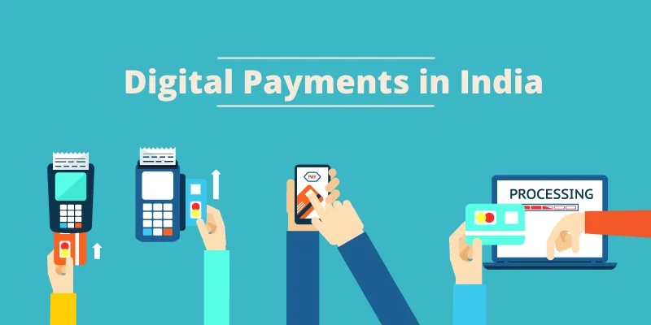

Slide 2
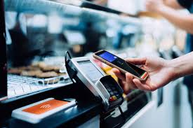
Digital payments are transactions made without using physical cash. Instead, money is transferred electronically using computers, smartphones, or other devices. This includes payments for goods, services, or even transferring money between people.

Slide 3
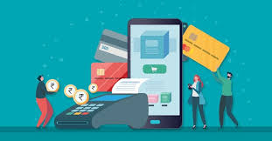
TYPES OF DIGITAL PAYMENTS
Online Bank Transfers
NEFT (National Electronic Funds Transfer): Transfers money from one bank to another.
RTGS (Real-Time Gross Settlement): For large-value transactions in real-time.
IMPS (Immediate Payment Service): 24/7 instant bank-to-bank transfer.

Slide 4

Mobile Wallets (e-Wallets)
Apps that store money digitally.
Examples: Paytm, PhonePe, Google Pay, MobiKwik.
You can link your wallet to a bank account and pay at shops or online.

Slide 5
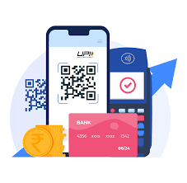
Unified Payments Interface (UPI)
A real-time payment system that connects multiple bank accounts to a single mobile app.
You can send/receive money, pay bills, recharge phones, etc.
Example: Using Google Pay to send ₹500 to a friend instantly.

Slide 6
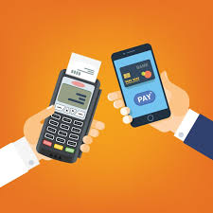
Credit/Debit Cards (POS & Online)
Debit Cards: Linked to your bank account.
Credit Cards: Let you borrow money up to a limit.
Used for online shopping, bill payments, and in-store purchases (via POS machines).

Slide 7
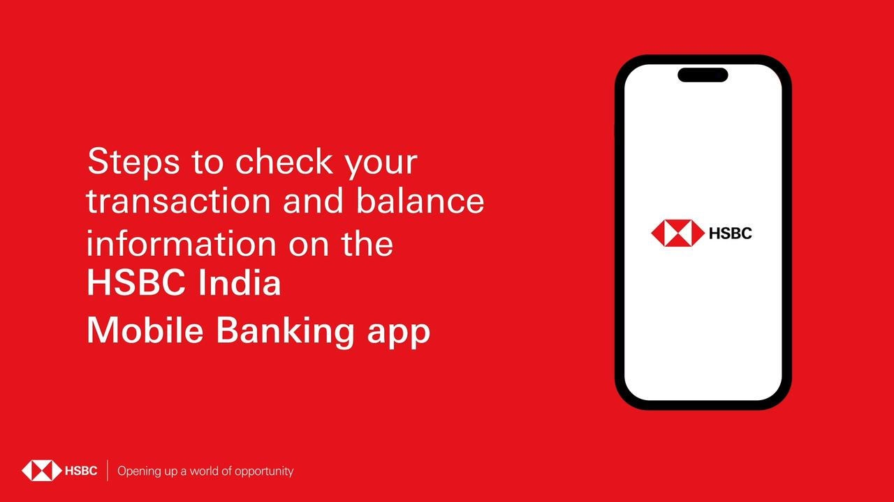
Mobile Banking Apps
Banks have their own apps for managing accounts, making payments, and transferring money.
Example: SBI YONO, HDFC Mobile Banking.

Slide 8
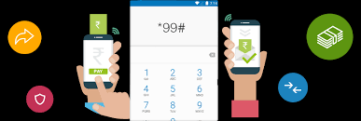
USSD-Based Payments (for Feature Phones)
For people without smartphones.
Use *99# to access banking services (e.g., transferring money via BHIM UPI).

Slide 9
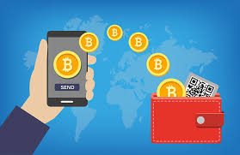
Digital Gold & Cryptocurrencies
Platforms allow people to buy gold digitally or even invest in cryptocurrencies like Bitcoin (though not legal tender in India).

Slide 10
HOW DOES IT WORK?
Initiation:
You open an app (like Google Pay) and enter the payment details.
Authorization:
The app verifies your account using an OTP (One-Time Password) or PIN.

Slide 11
Processing:
The payment request goes through banks or payment gateways.
Settlement:
The money is transferred instantly or within a few hours, depending on the method.
Confirmation:
You receive a notification confirming the transaction.

Slide 12
BENEFITS
Convenience: Pay anytime, anywhere without carrying cash.
Speed: Instant transactions, especially with UPI.
Security: Strong encryption and OTPs reduce fraud.
Tracking: Easy to track expenses and transactions.
Financial Inclusion: Reaches people in remote areas through mobile apps.

